Slide 1
Positioning, Overlapping and Background Elements

Slide 2
Session Objectives
To learn the positioning, overlapping and background elements
Notes:
Student Notes:
The objective of the session is to introduce the concept of services and how these are management. There are standards and frameworks that enable the organization to manage the services. These are also introduced in this session.

Slide 3
Session Outcomes
At the end of this session, participants will be able to
Able to write programs to position the elements in the web page

Slide 4
Agenda
Positioning of elements
Overlapping of elements
Background elements

Slide 5

Various positioning of elements

Slide 6
Placing a div element
<html>
<head>
<style type="text/css">
div
{ border: 4px double red; height: 150px; width: 200px;
text-align:center; font-size:18pt; }
</style>
</head>
<body>
<div> This is a sample paragraph </div>
</body>
</html>

Slide 7
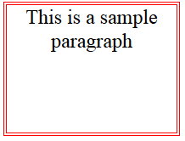
Output

Slide 8
Positioning of elements
Static - this is the default value, all elements are in order as they appear in the document
Relative - the element is positioned relative to its normal position
Absolute - the element is positioned absolutely to its first positioned parent
Fixed - the element is positioned related to the browser window
Sticky - the element is positioned based on the user's scroll position

Slide 9
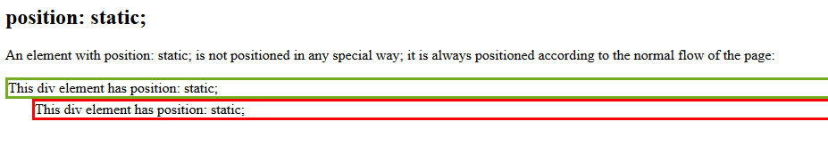
Static & Relative Positioning
.static {
position: static;
border: 3px solid #73AD21;}
.relative {
position: relative;
left:30px;
border: 3px solid red;}
<div class="static">
This div element has position: static;
</div>
<div class="relative">
This div element has position: static;
</div> → Element is relative its normal position

Slide 10
Absolute positioning
The positioning is done relative to the first relatively (or absolutely) positioned parent element. In the case when there is no positioned parent element, it will be positioned related directly to the HTML element (the page itself)
Example
<div id="parent"> Parent Element
<div id="child">Child Element</div>
</div>

Slide 11
Example
#parent {
position: relative;
width: 500px;
height: 400px;
left:100px;
background-color: #fafafa;
border: solid 3px #9e70ba;
font-size: 24px;
text-align: center;
}
#child {
position: absolute;
right: 40px;
top: 100px;
width: 200px;
height: 200px;
background-color: #fafafa;
border: solid 3px #78e382;
font-size: 24px;
text-align: center;
}

Slide 12
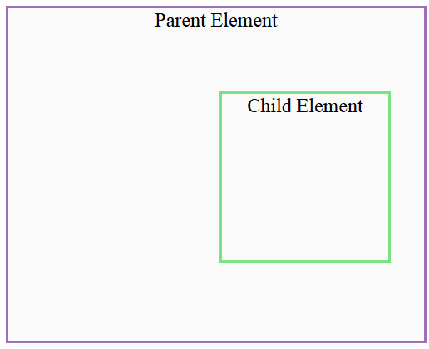
Output

Slide 13
Fixed positioning
</head>
<body>
<h2>position: fixed;</h2>
<pre>An element with position: fixed; is positioned relative to the viewport, which means it always stays in the same place even if the page is scrolled:
<div class="fixed">
This div element has position: fixed;
</div>
Repeat the same elements to see the effect of fixed positioning

Slide 14
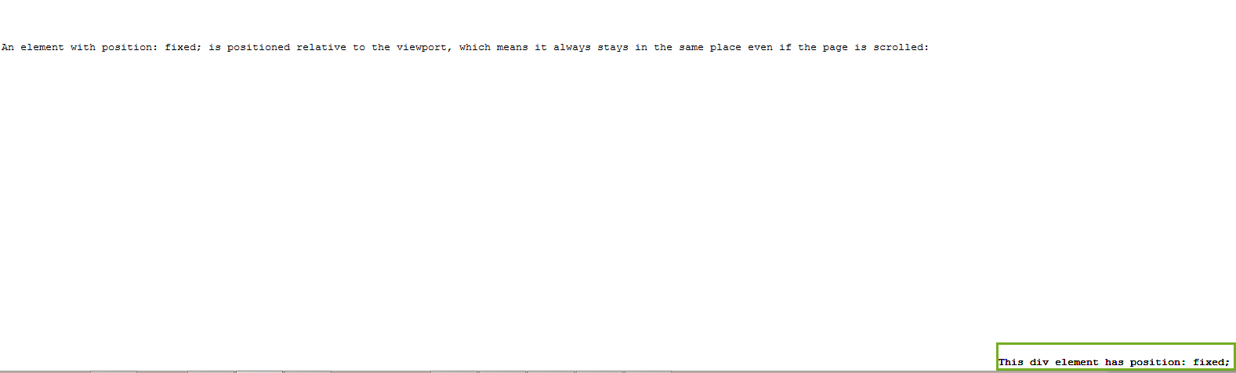
Output

Slide 15
Sticky positioning - Example
<html>
<head>
<style>
div.fixed {
position: fixed;
bottom: 0;
right: 0;
width: 300px;
border: 3px solid #73AD21;
}
div.sticky {
position: sticky;
top: 0;
padding: 5px;
background-color: #cae8ca;
border: 2px solid #4CAF50;
}
</style>
</head>

Slide 16
Example
<p>Try to <b>scroll</b> inside this frame to understand how sticky positioning works.</p>
<p>Note: IE/Edge 15 and earlier versions do not support sticky position.</p>
<h2>position: fixed;</h2>
<pre>An element with position: fixed; is positioned relative to the viewport, which means it always stays in the same place even if the page is scrolled:
<div class="fixed"> This div element has position: fixed; </div>
Repeat the same elements to see the effect of fixed positioning

Slide 17
Float positioning
<html>
<head>
<style type="text/css">
.bigNum {
float:left;
font-size: 50px; color:red;}
div {
border: 2px solid green;
height: 200px;
width:200px; }
</style>
</head>
<html>
<body>
<div>
<p> This text is going to float around <span class="bigNum"> I &nbsp;</span> big roman
numeral embedded within the paragraph, because the numeral is floated.
</div> </body>
</html>

Slide 18
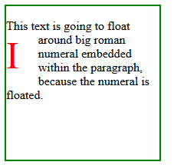
Output

Slide 19
Overlapping of elements

Slide 20
Example
<img src="w3css.gif" width="100" height="140">
<h1>This is a heading</h1>
<div> </div>
<p>Because the image has a z-index of -1, it will be placed behind the text.</p>

Slide 21
Example
img {
position: absolute;
left: 0px;
top: 0px;
z-index: -1;
}
h1 {
position: absolute;
left: 0px;
top: 0px;
}
div
{ position: absolute;
left: 0px;
top: 25px;
border: 2px solid green;
height: 200px;
width:200px;
background-color:red;
z-index: -1;
}

Slide 22
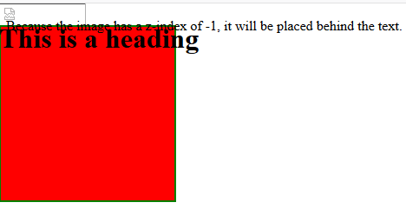
Output

Slide 23
Background image

Slide 24
Background images
<html>
<head>
<h1>Example Stylesheet</h1>
<style type="text/css">
body
{
background-image: url(sharan.jpg);
background-position: bottom right;
background-repeat: repeat-x;
background-attachment: fixed
}
</style> </head>

Slide 25
Summary
Details of positioning, overlapping and background elements

